Slide 1
Gym Website
By Simran, Raman and Manroobal

Slide 2
Pages in Gym Website
Homepage
Registration/Signup
Login
Admin Login
Other References about Gym
Contact US

Slide 3


Slide 4
Login Page
Login Page Has 2 Parts
HTML
PHP

Slide 5
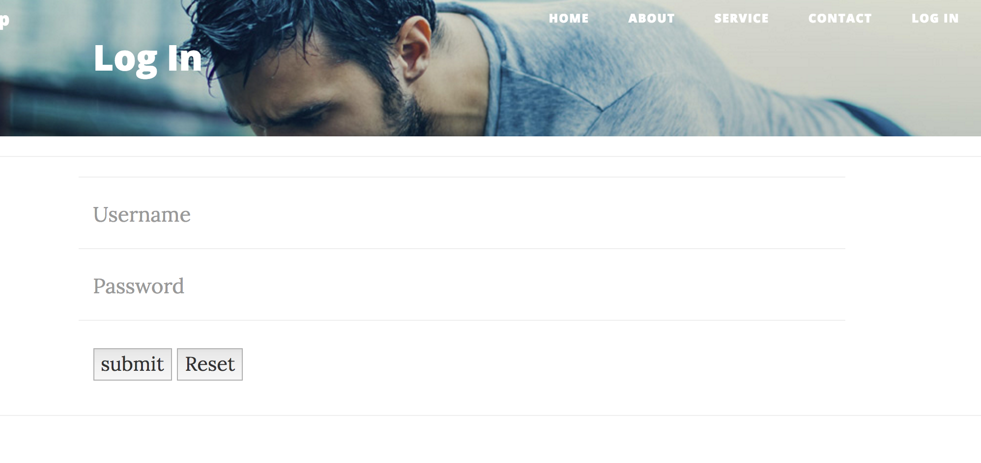

Slide 6
Registration Page
This Page is also known as Sign Up Page.
This Page will have 2 parts
HTML
PHP

Slide 7
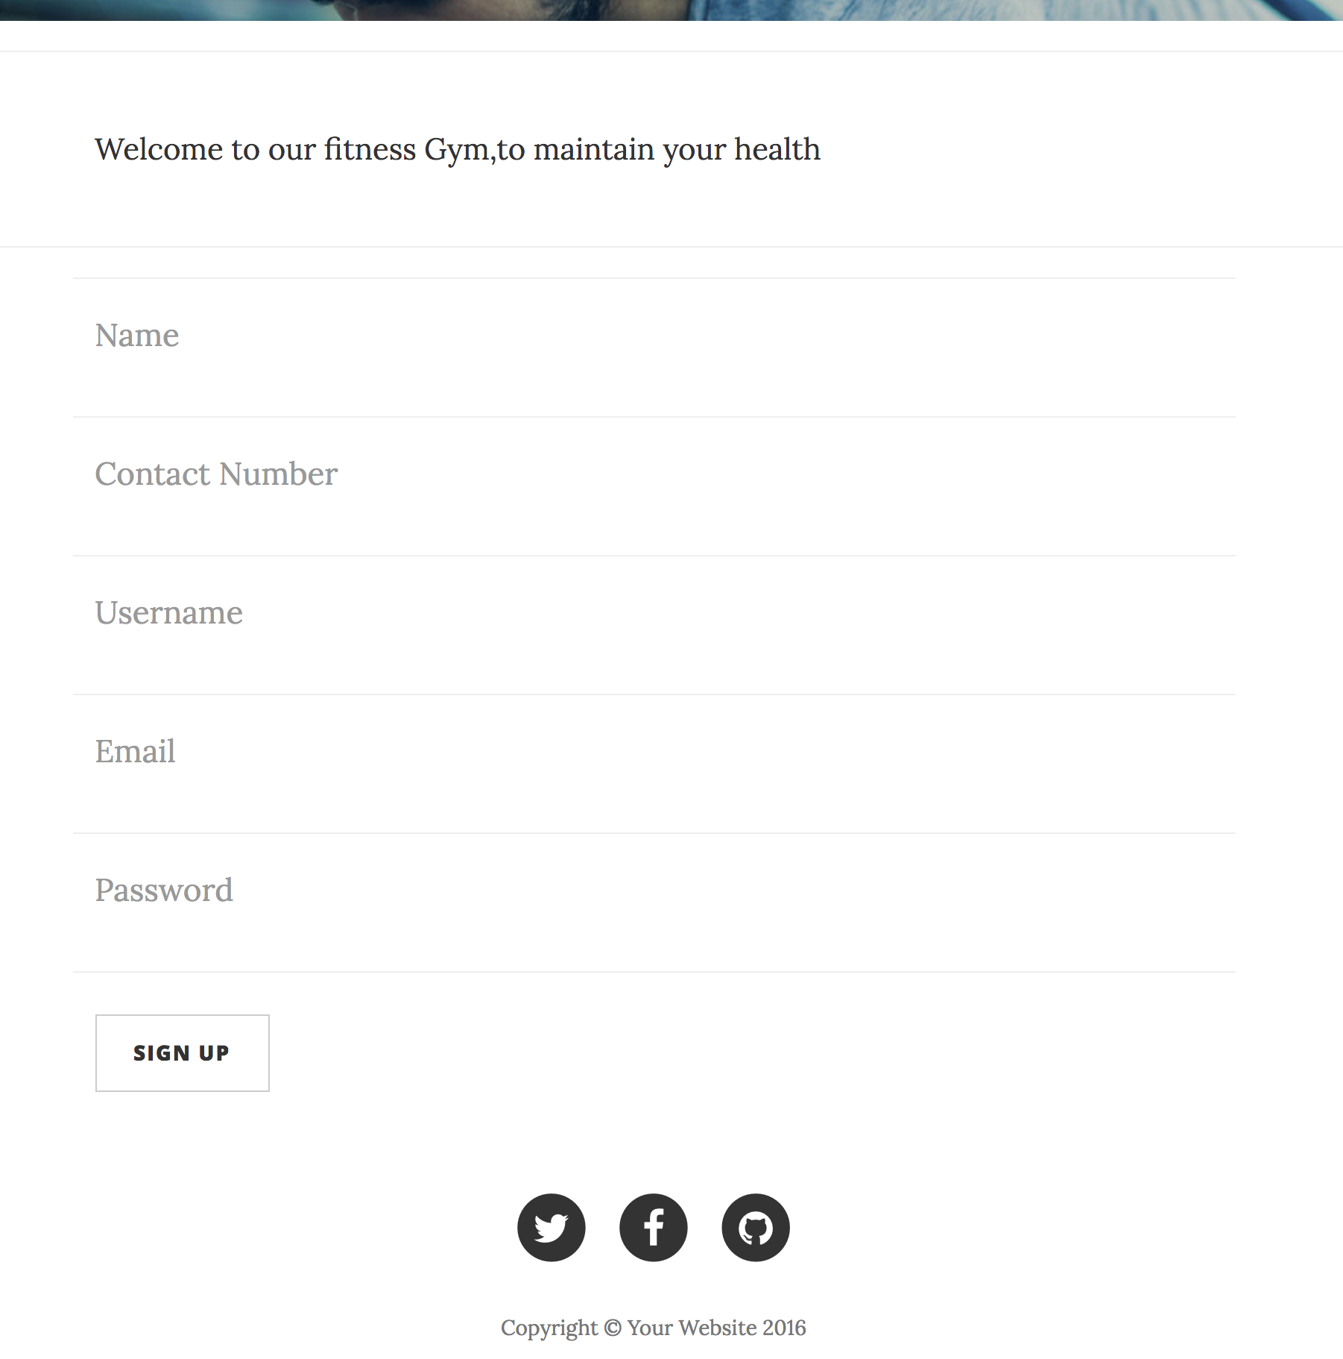

Slide 8
Database
Database will be created for website that will have same table for login and registration
Another Table will be There for add Activities or plans selected by customers

Slide 9

Activity Page

Slide 10
Gym Provide Different Classes
User can select classes from database and register
After registeration is complete ,data will be added to database
That database can be accessed by admin

